Slide 1
University Tycoon
Team Four:
Kent Irvin
Meghan Tennant
Tyler Adkins
George Hinkel

Slide 2
Content
Introduction
Business Objectives
System Objectives
Assumptions and Constraints
Project Schedule
Sample Components

Slide 3
Introduction
University Tycoon is a game where the player is in charge of running their own university. The player will decide where to place buildings and how to best manage the university. The goal of the game is to accrue as much money as possible while increasing the prestige of the university.

Slide 4
Business & System Objectives
Business Objectives
Start Up
Save/Load
Build System
Objects
User Interface
Gameplay

Slide 5
System Objectives
Android Platform
Game Engine: Unity
Programming Language: C#
Save data will be stored locally

Slide 6
Assumptions and Constraints
Assumptions
Database is not needed since game data is stored locally
Network functionality is not needed since game is played offline
No post project maintenance after the initial release
Constraints
Lack of android experience
Lack of game development experience
Time management issues

Slide 7
Project Schedule
Increment 1: March 1, 2018
UML Diagrams
Increment 2: March 22, 2018
SRA
Increment 3: April 12, 2018
Test Plan
Increment 4: April 26, 2018
Final Product and Presentation

Slide 8
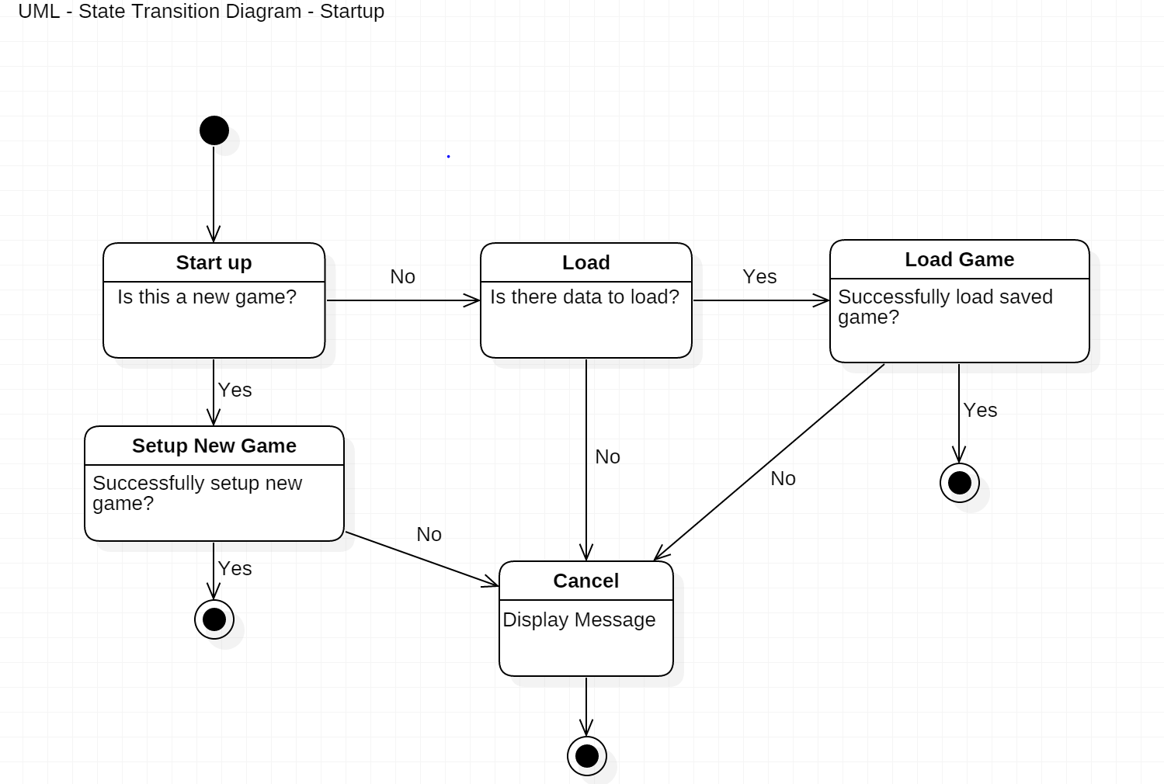
UML – Start Up

Slide 9
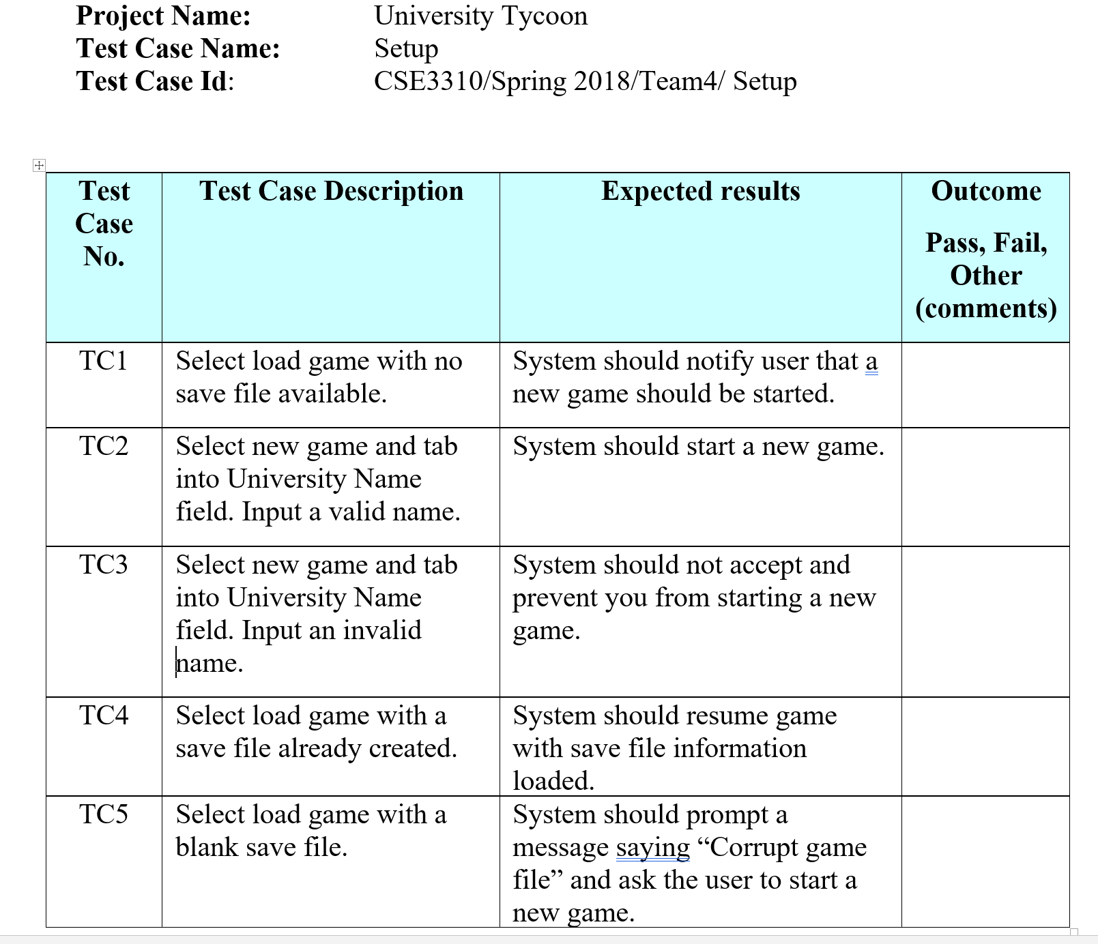
Test Cases – Start up

Slide 10
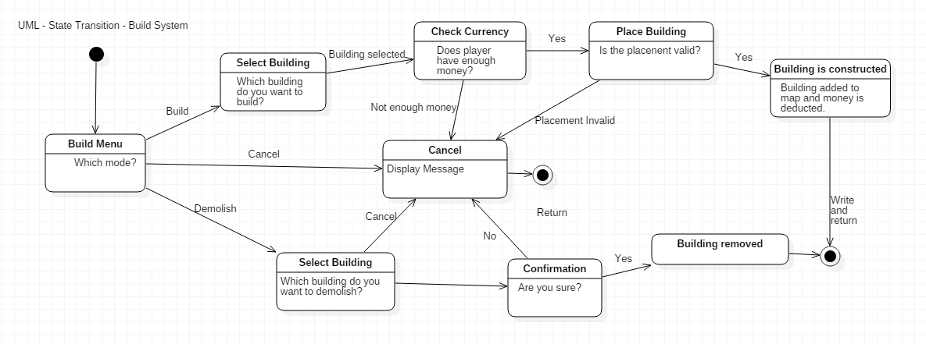
Build System Diagram

Slide 11
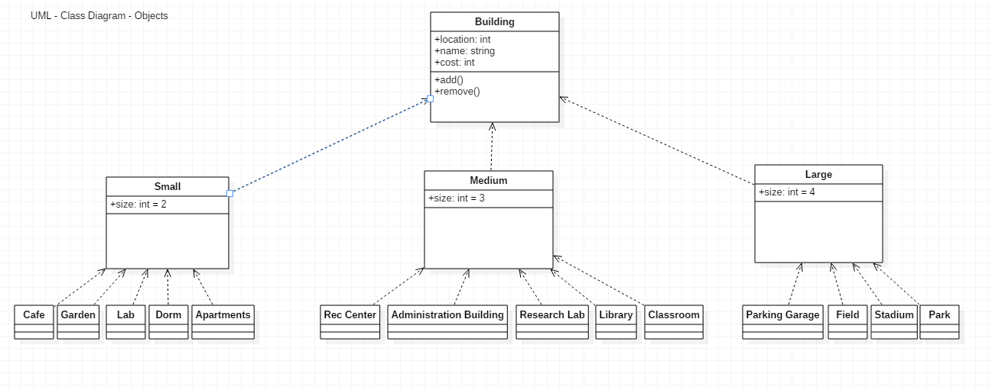
Objects Diagram

Slide 12
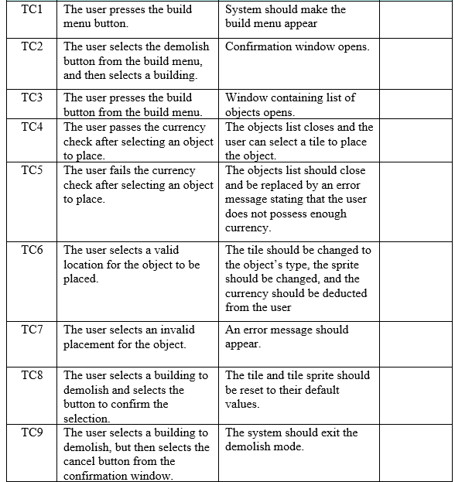
Build System Test Cases

